Slide 1



Slide 2
Hello Claude, so far the Council was able to pull through - app is running on Phase 1 along with the required post-mortem step. Now they are set for Phase 2 and I have created the EliteWrite logo as attached here

Slide 3



Slide 4


Slide 6


Slide 7
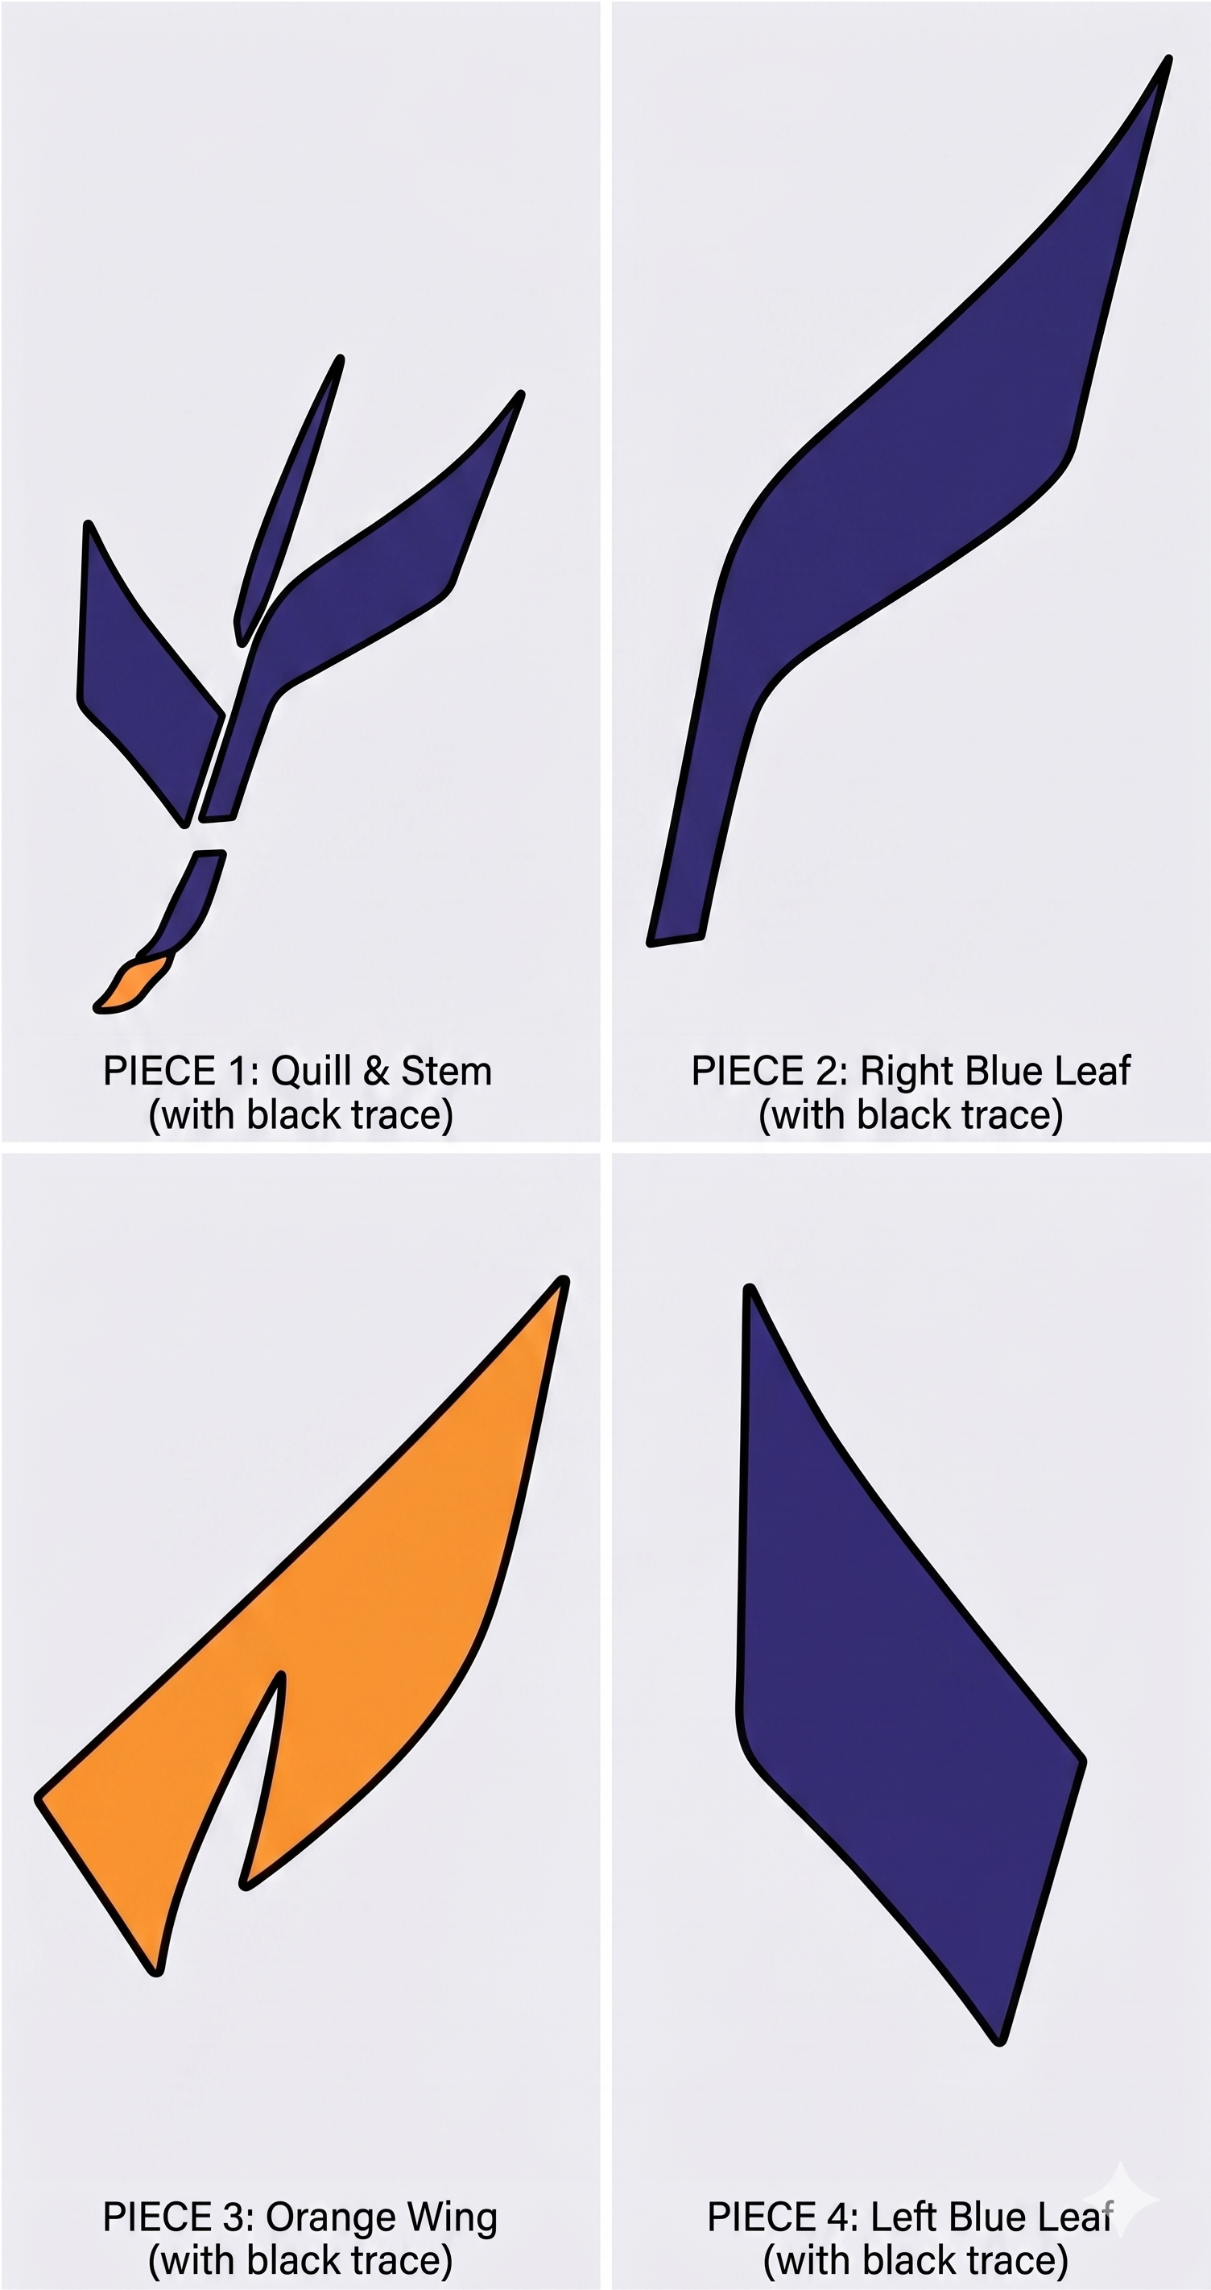

Slide 8


Slide 9
make an image for logo purposes of an abstract representation of a writing quill with a distinct combination of the following colors: orange #f38d01, vivid blue #1479ff, dark blue #0a0f1a, and dark grey #545454 for Elite Write concept.

Slide 10
